Slide 1
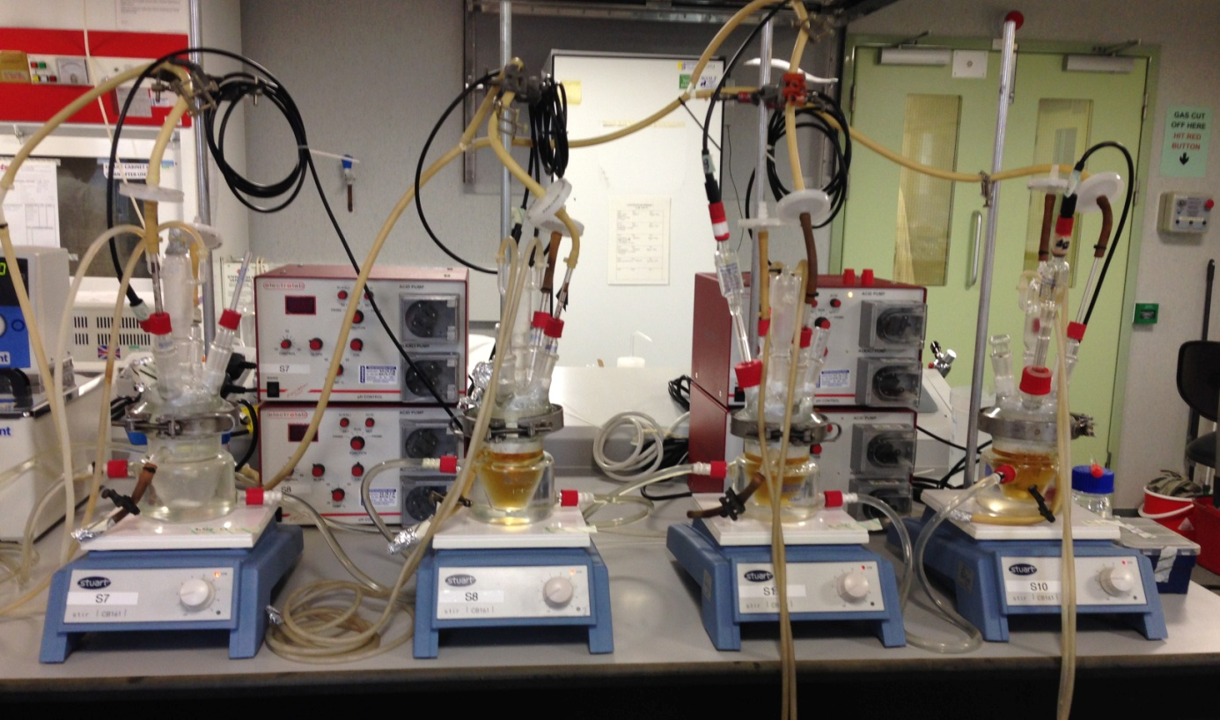
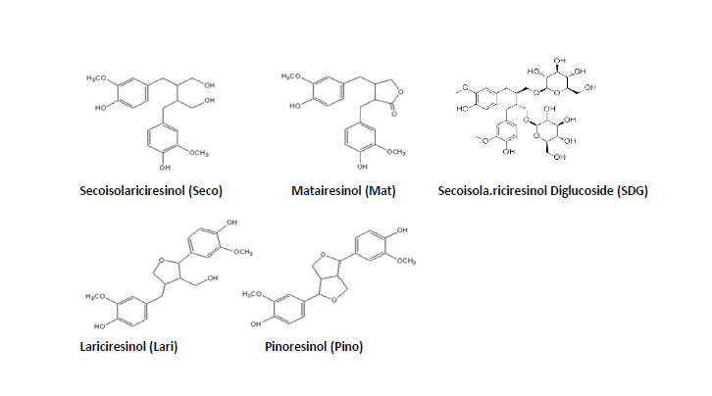
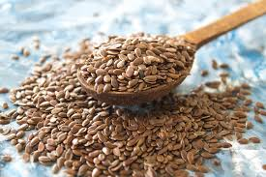
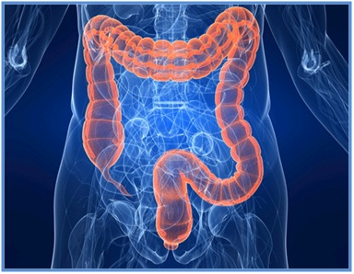
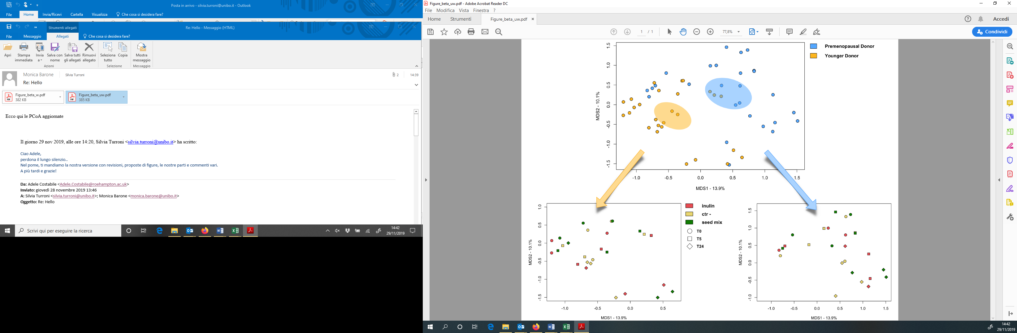
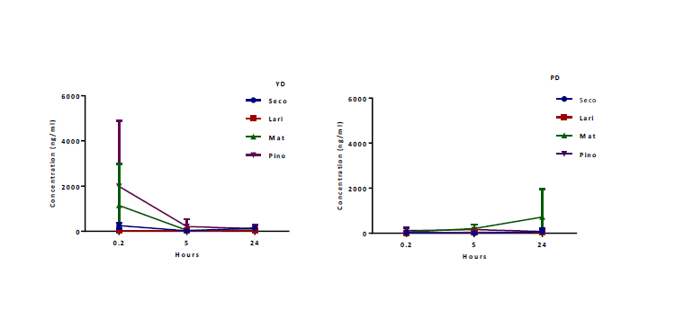
Faecal-derived microbial communities of premenopausal women separate from those of younger healthy women and are affected by oilseed mix
Both common and unique microbial signatures of response to the oilseed mix are observed in the faecal-derived microbial communities of premenopausal and younger healthy women
Dynamics of individual dietary lignans over 24 h of fermentation in faecal samples from younger healthy donors (YD, a) and premenopausal donors (PD, b) with added oilseed mix

